Slide 1

Let's Get Started
Sachin Agarwal

Slide 2
AWS Account Creation
Please navigate to the url : https://console.aws.amazon.com/console/home
Follow the instructions of your trainer

Slide 3
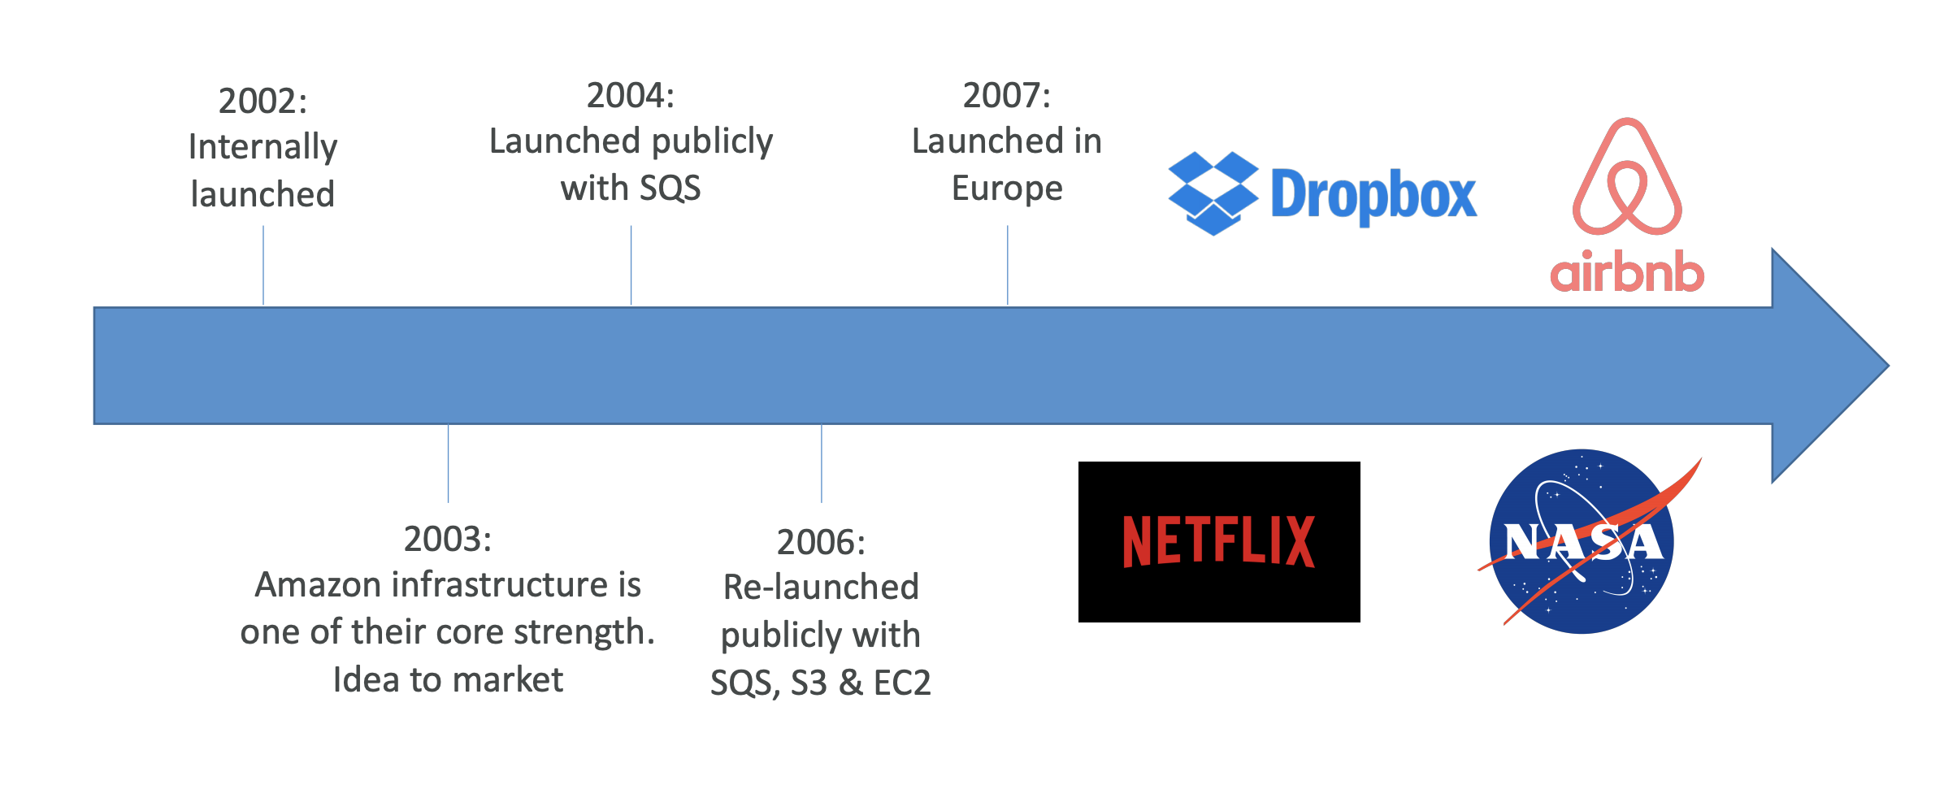
AWS Cloud history

Slide 4
AWS Use Cases
AWS enables you to build highly scalable applications.
It has a scope in different domains which covers wide set of industries.
Use Cases could be in any industry such as:
- Gaming
- Website Hosting, Social Apps
- IT Backup, Data Analytics, Data Engineering, Big Data, Machine Learning

Slide 5
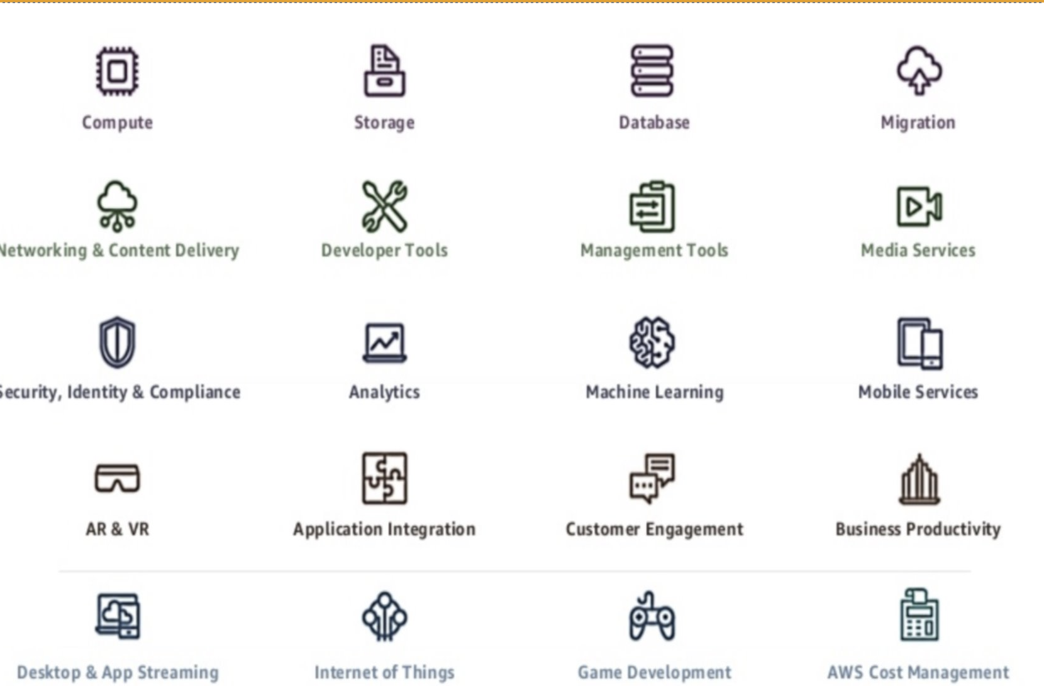
Internal Service Overview

Slide 6
Costing
Do you think your cloud costs are too high?
Let's discuss on the major factors which decides the AWS
Costing:
- Architecture
- Operations
- Pricing Models
- Cost Management
- Service Optimization

Slide 7
AWS Cost Explorer
Cost Explorer is an easy to use, free service that can help analyze and manage your AWS costs. It lets you dig into your cloud costs by account, service, tags, etc. You should use it to understand your cost analysis activities and to investigate any unusual or unexpected costs.

Slide 8
AWS Budget
Know your AWS costs before the bill comes to your email next month.
When you use AWS there is always the concern for how much you will be billed.
To be able to control this and set thresholds when you reach a certain value it’s good to make use of the billing tool already provided to you from AWS, you will be able to see exactly which service is costing which amount of money.

Slide 9
AWS Market Place Subscription
The marketplace is a great medium that AWS partners can use to sell their products. All you need to do in order to list your product in the Marketplace is simply be a Select Partner (first “stage” of AWS partnership.
You can use the marketplace for selling Amazon Machine Images (AMI) products as well as Software as a Service (SaaS) products.

Slide 10
AWS Application Post Profiler
Monitor applications for productivity, security, and compliance.
Managing application performance can be challenging as modern applications have many dependencies and their complexity can hinder realizing the benefits of moving to the AWS cloud.
End-to-end application monitoring, regardless of environment, provides the visibility needed in business today—enabling organizations to automatically discover resources, baseline application performance, and visualize the interactions of every component through flow maps that are built on real-time data.

Slide 11
Cost Anomaly Detection
Automated cost anomaly detection and root cause analysis
Reduce cost surprises and enhance control without slowing innovation with AWS Cost Anomaly Detection. AWS Cost Anomaly Detection leverages advanced Machine Learning technologies to identify anomalous spend and root causes, so you can quickly take action. With three simple steps, you can create your own contextualized monitor and receive alerts when any anomalous spend is detected. Let builders build and let AWS Cost Anomaly Detection monitor your spend and reduce the risk of billing surprises.

Slide 12
Rightsizing Recommendations
Right sizing is the process of matching instance types and sizes to your workload performance and capacity requirements at the lowest possible cost. It’s also the process of looking at deployed instances and identifying opportunities to eliminate or downsize without compromising capacity or other requirements, which results in lower costs.
Right sizing is a key mechanism for optimizing AWS costs, but it is often ignored by organizations when they first move to the AWS Cloud. They lift and shift their environments and expect to right size later. Speed and performance are often prioritized over cost, which results in oversized instances and a lot of wasted spend on unused resources.

